Slide 1


University Management Ontology: A Semantic Web Ontology for University Administration
COURSE: Knowledge Engineering
Submitted By
NAME: TANJID MASUM EMU
STUDENT ID: 20050945

Slide 2


INTRODUCTION
Many university systems struggle with disorganized and inconsistent data.
Ontologies help organize academic information in a logical, connected structure.
This project uses Protégé to model key components like students, faculty, courses, and examinations.
The aim is to improve system compatibility, enable reasoning, and support advanced queries.

Slide 3
OVERVIEW
Introduces a semantic model for managing university data using OWL ontology.
Developed using the Protégé tool to define classes, properties, and individuals.
Covers key academic entities like students, faculty, departments, courses, and events.
Demonstrates relationships and reasoning through object/data properties and queries.
Enables structured querying and intelligent insights using DL and SPARQL.

Slide 4
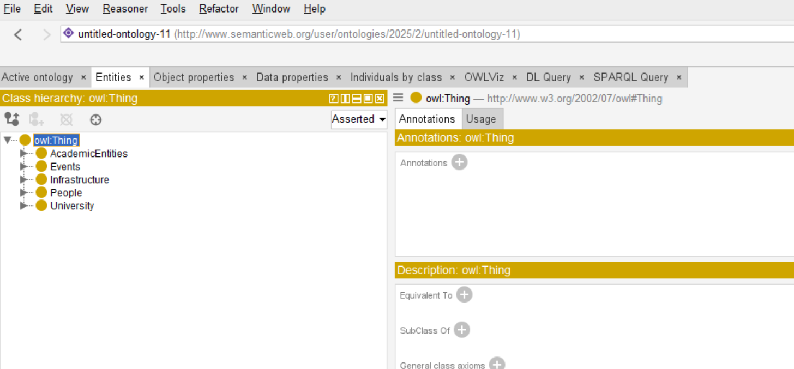
ONTOLOGY CLASS HIERARCHY
Five top-level classes define the core domains of the university system:
AcademicEntities
Events
Infrastructure People
University

Slide 5
SUBCLASSES IN ONTOLOGY HIERARCHY
The ontology uses a hierarchical structure with top-level classes, and every class has some sub-classes
AcademicEntities:
Course, Examination, Program, Research
Events :
AcademicEvent, CulturalEvent, Seminar, Workshop
Infrastructure:
Classroom, Laboratory, Library, SportsFacilities
People:
Faculty, Staff, Student
University :
Administration, Campus, Department

Slide 6
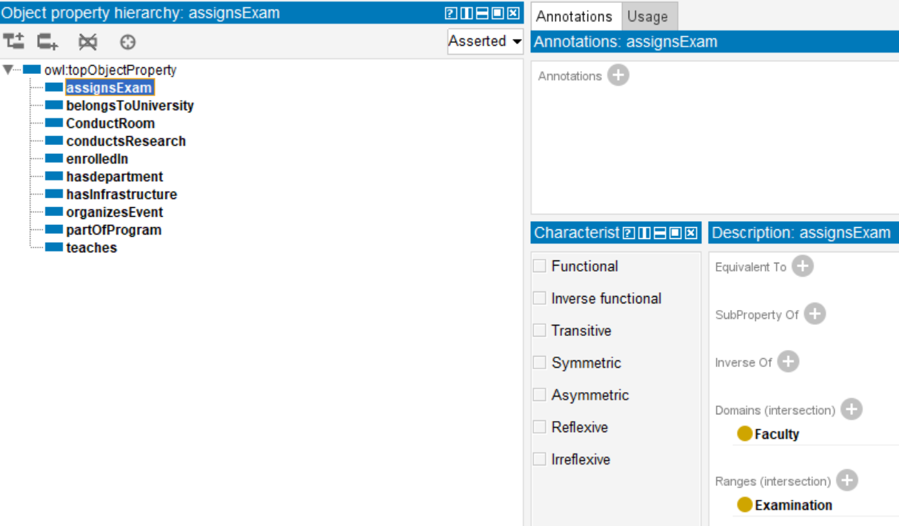
OBJECT PROPERTIES AND RELATION
Object properties define relationships between classes within the ontology. Each property connects a subject (domain) to an object (range), enhancing semantic meaning.
Key object properties in the University Ontology:
assignsExam – Links Faculty to Examination.
belongsToUniversity – Connects Department to University.
ConductRoom – Associates Examinations and Class with specific rooms.
ConductsResearch – Links Faculty to Research.
enrolledIn – Connects Student with Course.
hasDepartment – University includes Departments.
hasInfrastructure – University linked to its facilities.
organizesEvent – University manages Events.
partOfProgram – Courses linked to a Program.
teaches – Faculty teaches Courses.

Slide 7
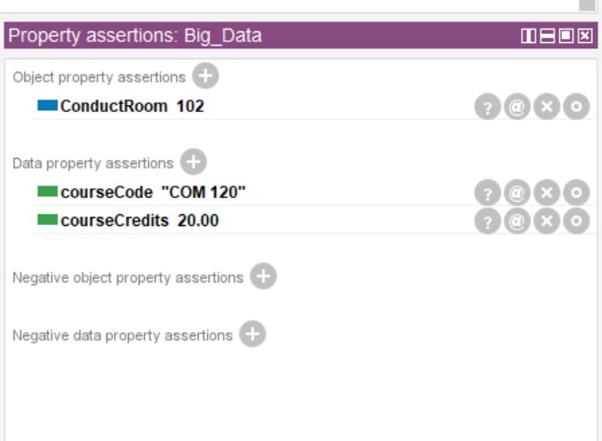
Data Properties
Data properties link individuals to literal values such as strings, integers, or dates. They help define specific attributes of classes
courseCode – Represents the unique identifier of a course
courseCredit – Indicates the number of credits for a course
eventDate – Captures the scheduled date of an event
facultyID – Unique identifier for faculty members
studentID – Unique identifier assigned to students

Slide 8
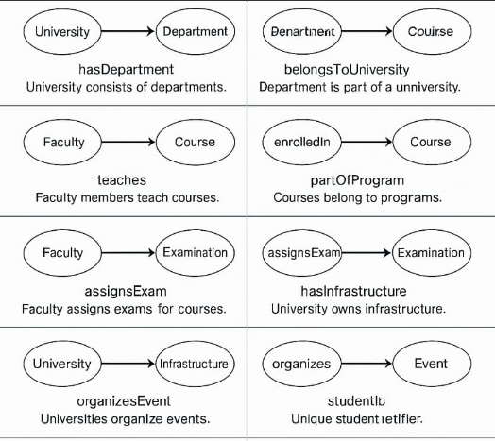
Relation Analysis
Student
enrolln
Faculty
assignsExam
Faculty assiagns examination

Slide 9
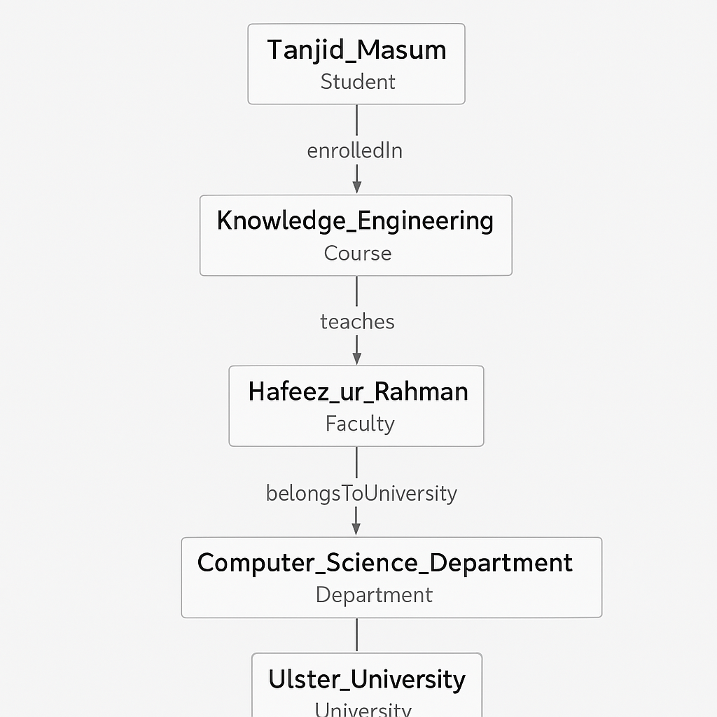
INDIVIDUALS EXAMPLE
Here we can analyze how this ontology relation works, and the figure indicates the relation between objects and classes.

Slide 10
EVALUATION
In this project, SPARQL queries were used to evaluate the correctness and completeness of the ontology. Because:
Queries ensured proper use of object/data properties and class association.
Queries tested relationships and attributes among individuals and classes.
Inferred knowledge through reasoning confirmed the ontology's semantic consistency.

Slide 11
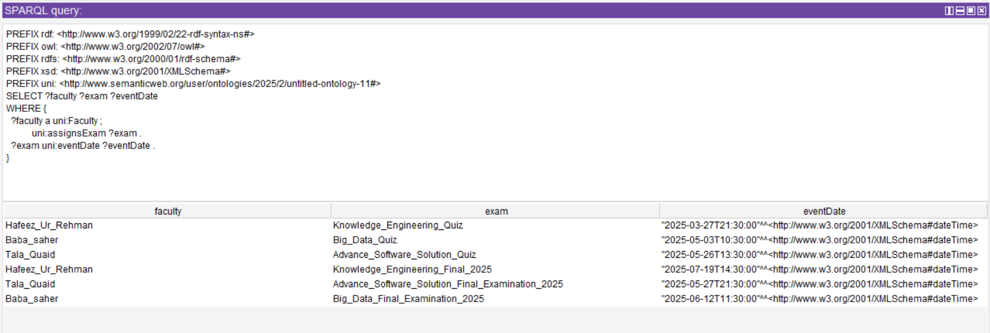
QUERIES
Queries 1: Find which Faculty member Assign Examination with Date and Time

Slide 12
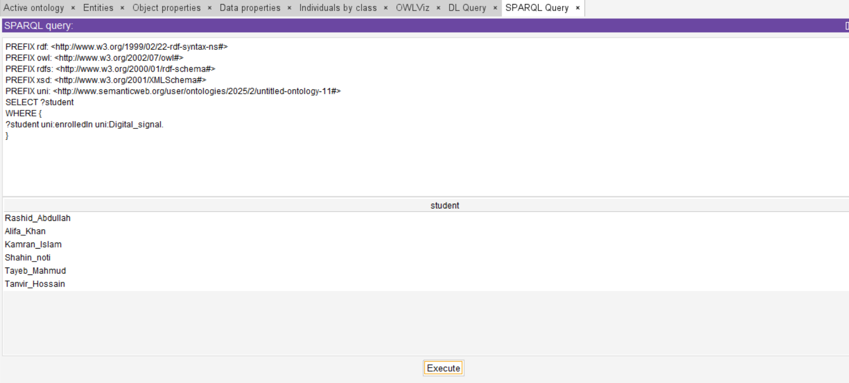
QUERIES
Queries 2: Find All Students Enrolled in a Specific Course.

Slide 13
CONCLUSION
The ontology-based model successfully represents core components of a university system using Protégé.
Classes, relationships, and individuals were structured for semantic clarity and machine interpretability.
Object and data properties allowed for rich interconnections and detailed information.
SPARQL queries and DL reasoning validated the ontology’s structure and usability.
This project demonstrates how ontologies can enhance data integration, consistency, and intelligent querying in academic environments.

Slide 14

Thank You

